Slide 1

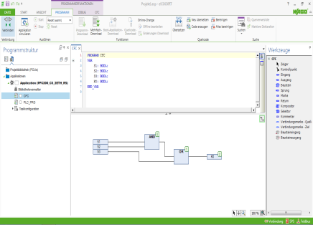



Programming
4
Function Block types
Exercises

Slide 2



Three types of modules
Function
Function
Programm
Mainprogramm
Function Block
Function Blocks
Notes:
A project contains different types of objects:
Modules
Definitions of data types,
Display elements (visualization), and
Resources
The first module that is created in a project is automatically named PLC_PRG
This starts the execution (corresponds to the Main function in a C program), and from here out additional components can be called like
Programs
Function Blocks (also called function modules)
Functions

Slide 3

“Function” module type
Function
A Function is a parameterizable module without memory, i.e. it always delivers the same results from the same input parameters
A Function delivers its results back to the accumulator
A Function has a data type
This means that a function can only deliver a data element as a result
Operator
Function
Notes:
The function in the POU
The Function is abbreviated 'FUN' and the key word is 'Function'. The function can be programmed as a parameterizable module in order to thus replace standard functions.
According to IEC 61131, it has been determined that the function may be assigned any number of input values. However, only one function value is returned. Thus, the module is used similar to an IL Instruction. Correspondingly, no output values can be assigned. Also, no Function Blocks can be called by a Function.

Slide 4

“Function Block” module type
Function Block
A Function Block is a module that delivers one or more values when executed
It can buffer values
There are IEC FBs, Manufacturer FBs, and User FBs
Notes:
The Function Block in the POU
The Function Block is abbreviated FB. As a key word, the designation 'FUNCTION_BLOCK' is used.
In contrast to Functions, Function Blocks can transmit several output and in-out parameters. The parameters must be not "switched" when called (with the exception of the data instance).
Inputs (INPUT), outputs (OUTPUT), and input/output (IN/OUTPUT) signals and values can be transmitted using the function block. A memory, the instance, is assigned to the function block, which is defined according to the module start.
When calling a FB, a data instance must be assigned to it. The data type of the data instance thereby always corresponds to the name of the FB.

Slide 5
“Program” module type
Program
A program produces one or more variables when executed
Programs are globally known in the entire project
A program can buffer values
Additional functions can start from the PLC_PRG main program
Program
Function
PLC_PRG
Program
Function Block
Function Block
Function
Notes:
The IEC 61131 modules for programming structure
Three modules types are standard in IEC 61131. The following module types are subordinate to the programming structure, which is designated as the 61131 “Program Organization Unit” (POU) in the IEC. These module types are designated as Program (PROG), Function (FUN), and Function Block (FB). A short description of the module types follows.
The Program
The most important part of a PLC program according to the IEC is the Program, designated by the abbreviation PROG. The key word has the designation 'PROGRAM'. This module type represents the main program, that was OB1 according to DIN 19239. Functions & Function Blocks are called in the PROG module. At the beginning of the module, the arrangement of inputs/outputs and global data are defined, which the remaining program then accesses.

Slide 6
Exercise 4.1
First program in LD
S1
Write a program with the following function
S3
S2
K0
Notes:


Slide 7
Exercise 4.2
Program in CFC
S1
S3
Write the program in CFC
S2
S4
S5
S7
S6
S8
K1
Notes:
You will find an explanation of the modules "AND" and "OR" in the appendix on page 6-3.

Slide 8
Exercise 4.3
Program with a timer
S1
S3
K1
Timer1
Add an ON delay for output K2 with a 4.75 s delay time to the program from exercise 4.2.
S2
S4
S5
S7
S6
S8
K1
Timer1
K2
4,75s
Notes:
You will find an explanation of the Timer modules in the appendix on page 6-8.

Slide 9
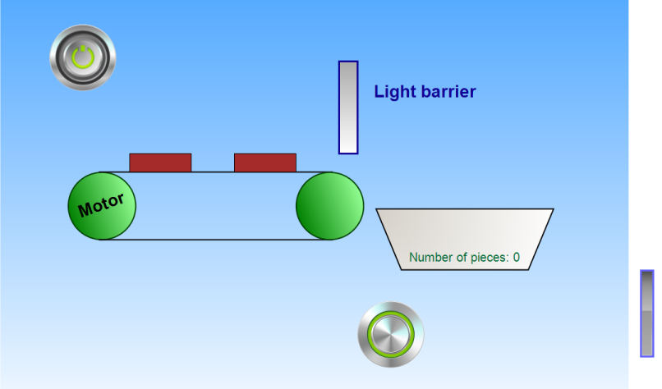
Exercise 4.4
Generate a ‘PLC_VISU’ with the elements depicted.
The system is switched using 'S1' to “RUN” and using 'S2' to “STOP”.
Using 'S3' simulates the “light sensor” that is used for counting the parts.
The “motor” runs as long as the counter has not reached the value 5 and the system is set to “RUN”.
The counter is reset by using “S4” (pallet change).
Notes:
Generate a project for controlling a conveyor belt with the following characteristics:
The system is activated via the RUN button (switch).
Activating the switch starts the motor for the conveyor belt (if the quantity is below the maximum value).
The conveyor belt transports packets to a palette, which can accept a maximum of 5 packets. The number of packets is determined by means of a light barrier.
If the maximum number of 5 packets is reached, then the conveyor belt stops.
The palette is then exchanged by the system monitor for an empty one, and by actuating the palette exchange button (switch), the quantity counter is reset to zero and the conveyor belt is restarted.
There is a STOP button to shut off the system, which shuts off the conveyor belt and deactivates the packet counter unit (The quantity status is not reset). The RUN button must be activated for restart. The RUN button must be activated for restart.
As an addition to the SPS program, generate a e!COCKPIT visualization, via which the system can be monitored or alternately operated.

Slide 10
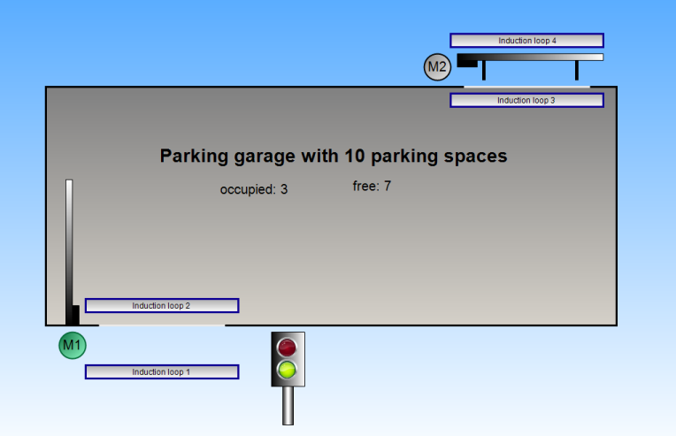
Exercise 4.5 (Optional)
Notes:
Add to the project for controlling a parking garage with the following characteristics:
The first barrier (M1) is opened by actuation of "Induction loop 1". By actuating "Induction loop 2", a counter (number of vehicles) is increased by one and the barrier (M1) is closed again.
The second barrier (M2) is opened by actuation of "Induction loop 3". By actuating "Induction loop 4", a counter (number of vehicles), is reduced by one and the barrier (M2) is closed again.
Counting may only function when the barriers are open.
If the maximum number of 10 vehicles is reached, the traffic light at the entrance to the parking garage switches from green to red and the entrance to the parking garage is blocked.
Additional task:
Expand the project by a variable specification (input field in VISU) of the maximum number (CAR_MAX) to be between 10-50 vehicles.
Using the program, determine the number of available parking places and display this at the entrance to the parking garage.

Slide 11
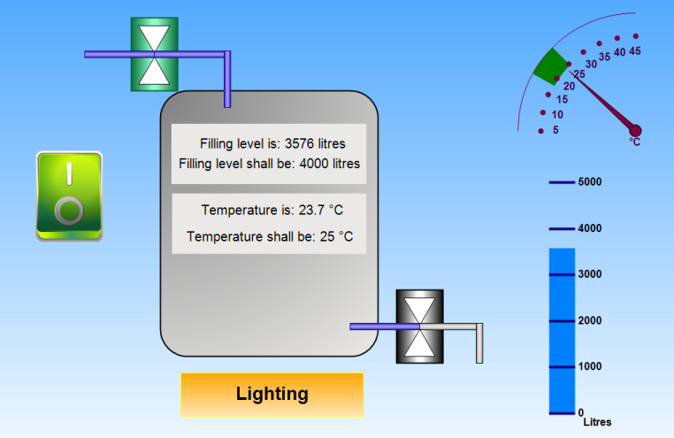
Exercise 4.6
Boiler

Slide 12
Exercise 4.6 (description)
Boiler
Implement a boiler control, by means of which a water boiler can be filled and heated. The system should be started/stopped using a Start/Stop button.
At a filling level of 4000 liters, the supply should be closed. The fill level is determined using a 0-10 V module..
At a temperature above 25°C, boiler firing should be stopped. The temperature is determined by means of a thermocouple.

Slide 13
Exercise 4.7
Addition
In order to protect the burner, it should be switched via a hysteresis function.
25°C
25°C
20°C

Slide 14
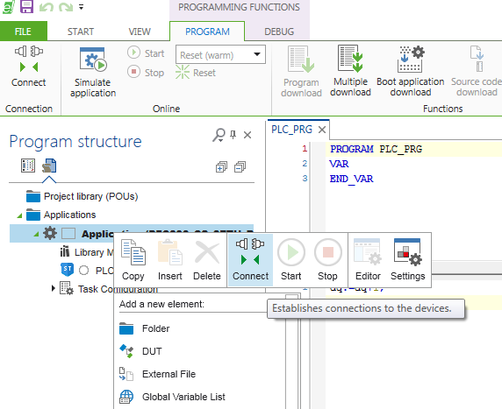


Download the program in device (RAM)
By click of the right mouse button on application, or connection under the program ribbon
After connection, donʼt forget Start

Slide 15
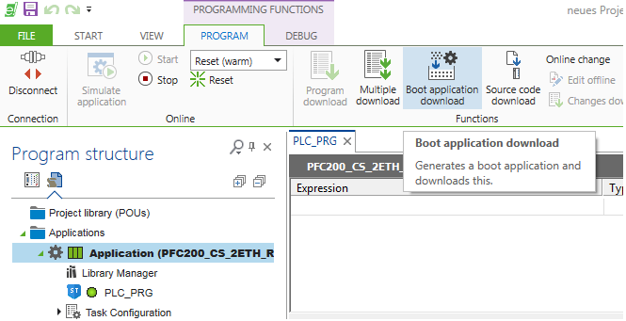
Download the program in device (Flash)
For permanent saving, boot application- download under the program ribbon

Slide 16
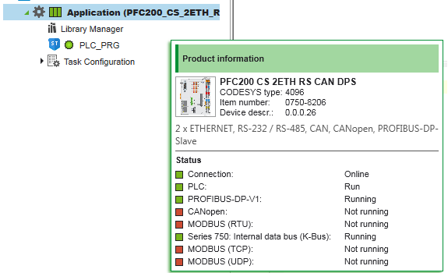
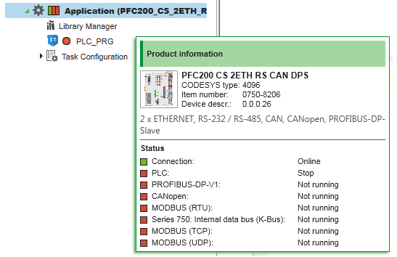
Diagnostics
The state of the controller is indicated by the status field
Left: Connection state
Center: Run/ Stop
Right: Fieldbus/ K bus state

